Slide 1
Code Red
Worm
By: Harjap Saini

Slide 2

Overview
The whole world was attacked by this worm in 2001
Originated in China
Copies itself on to other computers

Slide 3
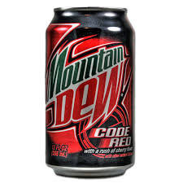

Fun Fact
The name is Code Red and Mountain Dew

Slide 4

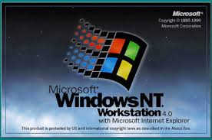

Targets
Windows 2000 and Windows NT
Microsoft Internet Information Service
Internet

Slide 5
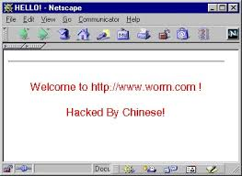
What it DOES
Affects computer through the internet
Takes control of webpage
Hard drive data erased
Shows message on webpage screen

Slide 6
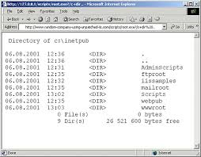

How it WORKS
Exploits vulnerability in Internet buffer overflow.
Creates copies of itself to attack other computers and webpages

Slide 7

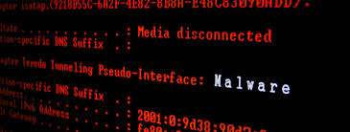
Its EFFECTS
Attack lasted 19 days
Total damage estimated to be in the billions
Between 1-2 million users affected
Biggest malware attack of 2001

Slide 8
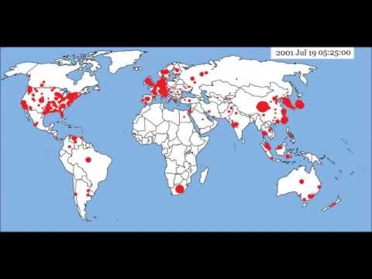
1.
Transition headline
Let’s start with the first set of slides

Slide 9
Its CONTROL
Discovered by Marc Maiffret and Ryan Permeh
Solved by Windows Patch

Slide 10

The END
Thank You for your attention

